Slide 1
CSE332 INDUSTRY ETHICS AND LEGAL ISSUES

Slide 2
Patents

Slide 3
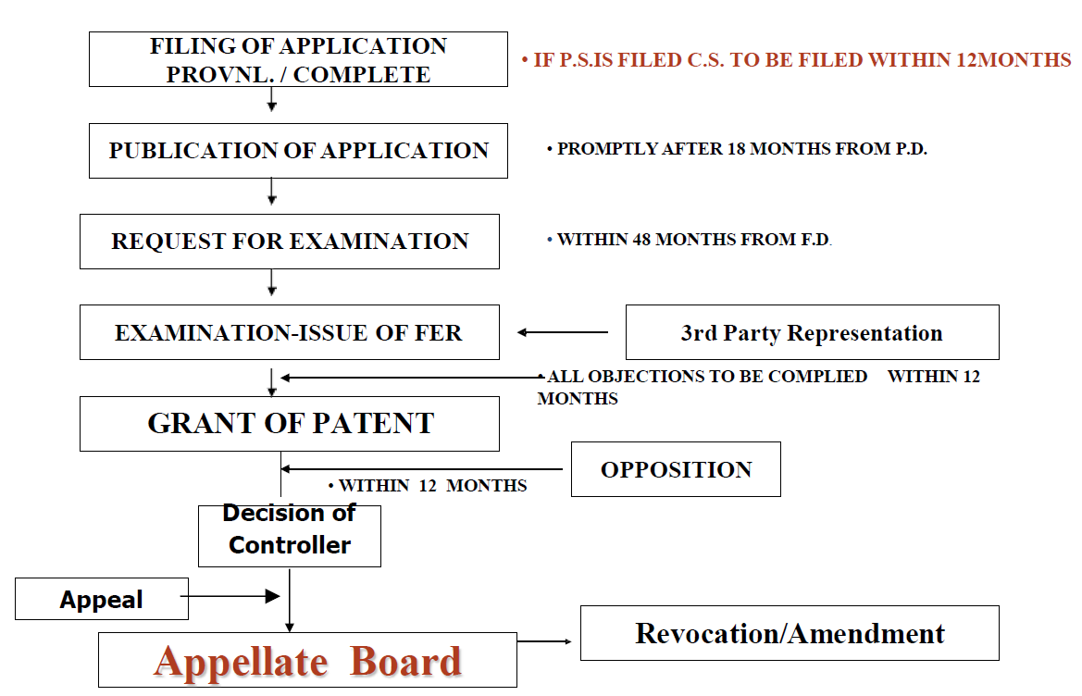
Stages from filing to grant of a patent

Slide 4
The Intellectual Property Appellate Board was abolished in 2021.

Slide 5
Publication and Examination
Rule24-B:Examination of application
Examination request for application:
1. 48 months from filing date or priority date, whichever or 6 months from further application filing.
2. Controller refers to Examiner within 1 month from publication or examination request receipt date whichever is earlier.
3. Examiner prepares report in 1-3 months.

Slide 6
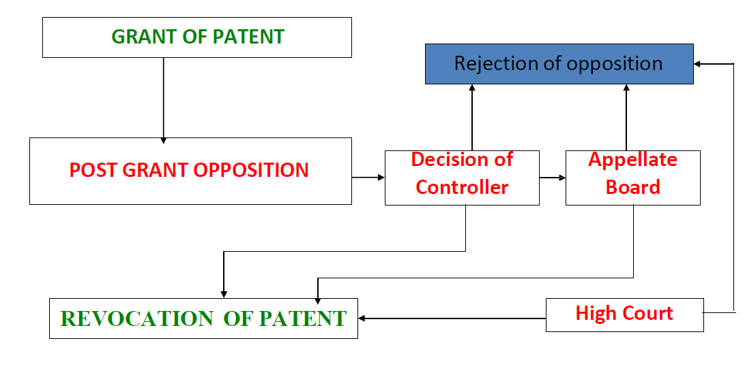
A PROCEDURE FROM FILING TO
GRANT OF PATENT (Cont.)

Slide 7
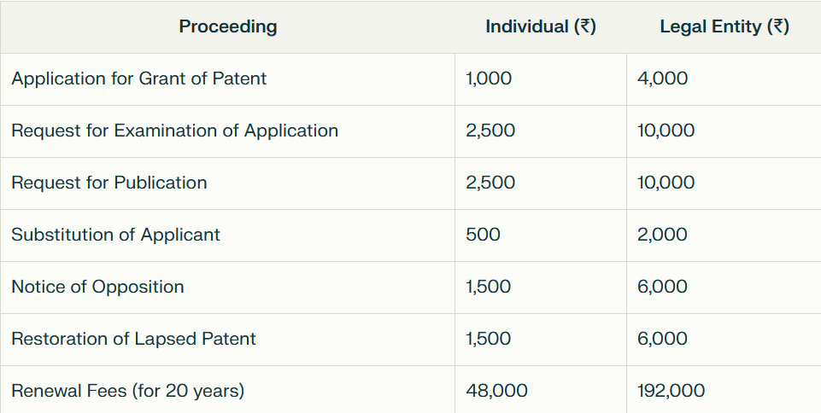
IMPORTANT FEES IN DIFFERENT PROCEEDINGS

Slide 8
DUTIES OF PATENTEE
Maintenance of the patent
Pay renewal fees
Every year till the end of the term
Time limit:
before end of the preceeding year ( 6months extn. Available )
Working of the patents:
Inventions are to be worked in India on commercial scale

Slide 9
Litigation vs Licensing
If the objective is to stop a
competitor from offering a
product that infringes one’s patent.
If the objective is to obtain royalty
for the use of one’s invention.
Alternatives To Litigation
Litigations are costly, timely, & disruptive
Alternative dispute resolutions (ADR) include Mediation & Arbitration

Slide 10
ADR refers to methods of resolving disputes without going to court.
Common types:
1. 🤝 Mediation
A neutral third party (mediator) helps both sides reach a mutual agreement
Non-binding (decision is not imposed)
Features:
Informal
Confidential
Faster and cheaper
Preserves relationships

Slide 11
2. ⚖️ Arbitration
Dispute is decided by an arbitrator
Binding decision (called an award)
👉 Features:
More formal than mediation
Faster than court
Decision is enforceable like a court judgment

Slide 13
SciSpace
Best for: Understanding technical papers
Use it to:
Read research papers quickly
Identify unsolved problems (great for patent ideas)

Slide 14
Lens.org
Best for: Finding research + patent gaps
Why it’s powerful:
Combines academic papers + patents
Helps identify areas where innovation is needed

